Slide 1
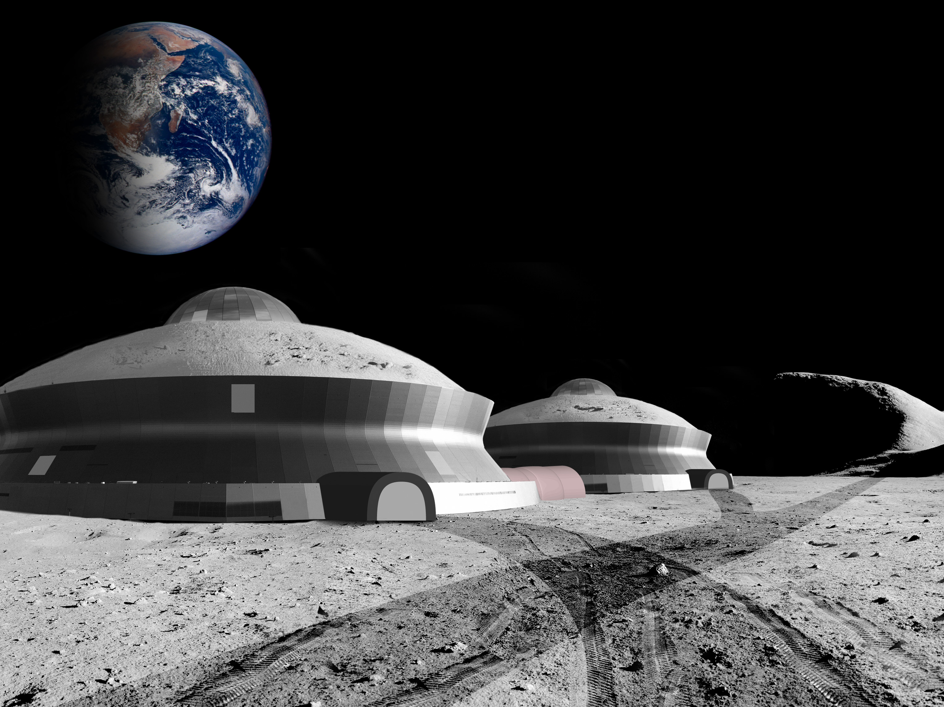
An O’Neill Lunar Colony
Living on the Moon in the next decade
Dr. James R. Wertz
Microcosm
3111 Lomita Blvd.
Torrance, CA 90505
(310) 539-2306
jwertz@smad.com
USC/Microcosm
May, 2022
Mic22-1155

Slide 2
The Consequences of Developing the O’Neill Lunar Colony
A consequence of an O’Neill Lunar Colony is that, in the not too distant future, one or more of the folks hearing this briefing or reading the charts, or possibly someone that works with you or for you (or is you), could be living and doing research on the Moon for several months or a year or two.
It would be a remarkably exciting job and lots of people would be interested.
It would be remarkably exciting for the rest of us to watch.

Slide 3
Summary
Studies and Speculation have been ongoing for decades on building colonies on the Moon and planets to allow humankind to expand into the solar system
in 1974, Gerard O’Neill at Princeton initiated an extensive discussion of building large human colonies in space, away from any moons or planets
By moving an enclosed O’Neill-style colony to the surface of the Moon, we can dramatically reduce cost, provide clean nuclear energy for Earth, provide a fun and romantic tourist destination like no other, and generate $100 billion/year near-term income from multiple lunar sources.
1. No new technology needed – We can start today
2. Most work will be done inside using normal Earth equipment
3. Living on the Moon will generally be safer than living on Earth
4. Use oxygen, and possibly hydrogen, from the Moon as propellants to dramatically reduce transportation cost
5. Estimated income at the start = $10B/yr (modest profit to start)
6. Estimated income when up and running = $100B/yr with lots of profit
7. Any business that can operate at labor rates 2 - 3 times that of the US can be profitable on the Moon – this creates remarkable advertising
Working on the Moon can be highly profitable, provide clean energy for Earth, and be fun, safe, exciting, and satisfying to both watch and be a part of.

Slide 4
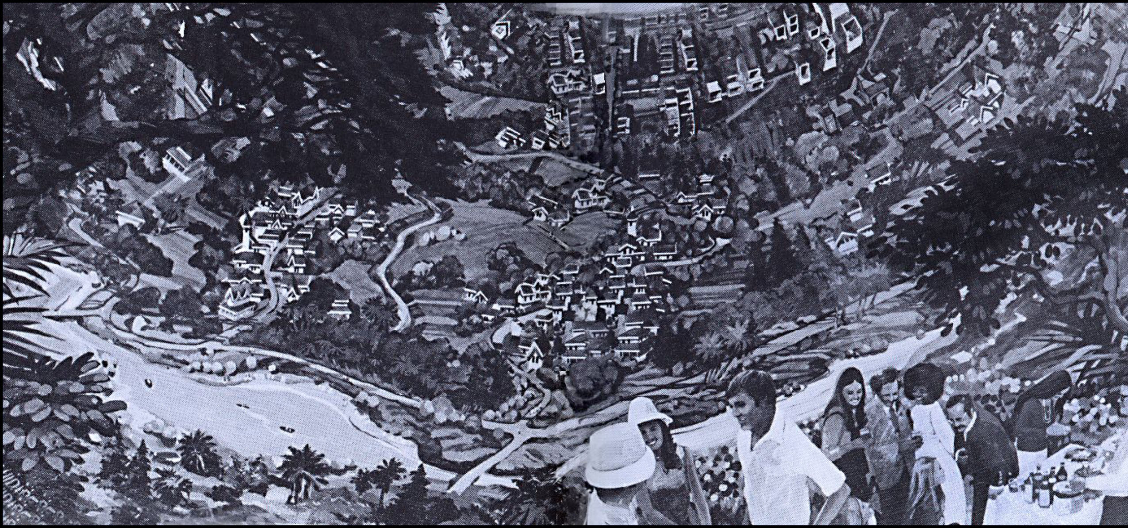
The O’Neill Lunar Colony – Dramatically Reduce the Size of an O’Neill Space Colony and Move It to Surface of the Moon
O’Neill Lunar Colony
• 2 domes for 1,000 people, each with twice the area of a 100,000-person stadium
• Excellent living conditions for an extended stay in 1/6th g
• Nearly all the raw materials are already on the Moon
• Can do most of the work inside, rather than outside
• Can use everyday commercial equipment brought from Earth
Many sources of external income from work not required to support the colonists
³He for Earth • Space Tourism • Lunar Burial
Entertainment/Sports • Co-branding • Many more
An interesting idea, but how do we do it and what are the risks?

Slide 5
What Are the O’Neill Lunar Colony Objectives?
Near Term
Want to start work on the Colony today
Want to start building it within 2-3 years
Want income generation to start as soon as we start building it (or maybe sooner)
Want a full-scale Colony on the rim of Copernicus within 10 to 15 years
Low Cost
Estimate for a 1,000-person lunar colony: $3B to create, $13B to get to the Moon over several years, and $2B/yr to support, with no more than 10% from one company or country
Will work very hard to drive down cost. May not meet the objective above, but I expect that we can come close
Will work from the outset in an “industrial” mode – finding the right balance in what we undertake and doing it quickly, safely, and at low cost, but not “optimally”
We want to build on the remarkable work that NASA and the space community (US and international) have done over 50 years and create a robust environment for human expansion to the Moon to benefit all of us and particularly those who help make it happen.

Slide 6
O’Neill Lunar Colony Objectives – 2
Low Risk
Low technical risk – using primarily existing technology, most of it inside the colony
Low to moderate financial risk – High profit margins with 20+ ways to generate income
Safer for people than living on Earth – In some respects the lunar environment is harsh, but floods, hurricanes, earthquakes, and poisonous snakes don’t exist and nothing in the environment regards you as lunch
Getting there is the riskiest part. We’re currently working on responsive launch, a key technology for in-space rescue, as identified by Dr. Grant Cates of Aerospace Corp
High Income – even as we start out
Intended specifically as a business that generates income from the start and grows rapidly over time
At start-up income from construction, O2, and some science and tourism
Income when we’re up and running from ³He, lunar burial, gravitational biology, education, advertising, co-branding, lots of tourism, and lots more
Some businesses will make money, some will not. (If McDonald’s fails, Burger King takes over that slot)
These are good objectives. The real question is how do we achieve them?

Slide 7
Valuable (but not necessarily critical) Elements for Building a Near-Term Lunar Colony
1. Commercial/Industrial Approach
Want colony construction to be driven primarily by businesses with inputs and cooperation from government, academia, and individuals
2. Emphasis on Near-Term Profits
Want to generate income in the near-term, even before the first lunar colony is built
Think of lunar colonies as analogous to settling California – a series of individual actions by multiple organizations and people, rather than a single grand plan – this gives more opportunities for success
3. Use of Graduate Students for both Research and Generating Enthusiasm
Want graduate students from a wide variety of disciplines (economics, law, marketing, geology, biology, astrodynamics, and more)
Doing work both on Earth and among the first lunar residents
We want to change the paradigm for building a lunar colony from a planned science and technology experiment controlled entirely by Earth governments to a business, entertainment, and profit-oriented set of companies literally creating “a new world on the Moon.”

Slide 8
Getting Underway
On Earth – create the USC Near-Term Lunar Colony Research Group (N-TLCRG)
Want a government, academia, and industry organization with ideas from all
Want an inclusive organization that can look for multi-element solutions
The biggest single objective is to find ways to make money from the outset
On the Moon – we anticipate that the first active lunar company will be a for-profit Real Estate Developer (RED)
Will build the first lunar colonies and then sell, lease, or rent the real estate that was created to business, governments, or individuals
First products (before the colony is complete, or even started) are O2 sent to LEO to dramatically reduce the cost of subsequent flights and water for use on the Moon – planting for growing food on the Moon will start quickly
The first small colonies (2 for safety) will be a “House” for people to live in and a “Garage” for working in
The House will be about 100 m in diameter (85,000 ft²) and 10 m high; the garage will be smaller; CisLune will build a small landing pad on the regolith
Likely located where water has been found near the pole
The first people on the Moon will be builders and business start-ups (along with a few researchers and tourists) getting stuff set up and getting underway on things the colony needs or that make a profit.

Slide 9
The USC Near-Term Lunar Colony Research Group (N-TLCRG)
The basic goal is to do the needed lunar colony research on the Earth and on the Moon by graduate students in many fields -- a group that is inherently strongly interested in the results and can interest others
Key issue – this is not an astronautics problem, but a social, legal, marketing, business, and government problem with some astronautics
Representative research topic areas
Economics – build an economic model of cost vs. income
Law – Is it legal to own and sell lunar property or materials?
Marketing – How to sell lunar sports, tourism, products, and sex on the Moon?
Business – Create a business case for multiple lunar businesses
Real Estate Development – How do we build and sell or lease lunar colonies?
Government – How do we create and set up a lunar government?
Power Source – How do we mine and use ³He to provide safe power for Earth?
Architecture – How do we design a lunar colony for all of these businesses
Gravitational Biology – Plants, animals, and humans in 0 g, 1/6th g (Moon), 0.4 g (Mars), 0.6 g, 1 g, 1.2 g, 1.5 g – the gravitational biology wheel
Education – teaching students of all ages about the Moon
Sports and Entertainment – What are the major activities to generate income?
Science and Exploration – Tremendous potential for long term growth
The graduate student population could be key to generating interest.
We need to develop both income and popular interest in living on the Moon.

Slide 10
Start by Generating External Income = Income not Associated with Living on the Moon
Once colonies are built, initial external income is estimated to be in the range of $10B to $35B per year, rising quickly to $100B to $800B
However, colonies will generate income even before the first colony is built, depending on the Phase of Development:
Phase 0: Planning only; no work being done on the Moon; some income available
Phase 1: Lunar start-up; setting up small initial colony to begin work on the Moon
– 2 colonies (for safety), likely adjacent to water source near the pole
– 1 colony for living, 1 “garage” for working, building, and repair
– Beginning low level of commercial activity – tourists, ³He, O2 for travel, building more colonies, some student research
Phase 2: Initial development small colonies in multiple locations
– Tycho colony for lunar burial
– Start of substantial services for Earth (³He, mining, diplomats, science, tourism); building the large colonies at Copernicus and elsewhere
Phase 3: Large colonies up and running, 2 or 3 on the rim of Copernicus
We don’t want to ignore science or exploration, but the first activity on the Moon is to start businesses that serve a few folks on the Moon and millions watching from Earth.

Slide 11
Initial Annual External Income – Phases 0-2 (Income not Associated with Living on the Moon)
Some external income will be created even before the first colony is built
Initial external income is estimated to be in the range of $10B to $35B per year
Source | How sold | Basis | Pre-Sale* | Amount
Tourism | “In-House” stay | 6 tourists/mo @$4M each | Yes | $0.3B
Space Burial | Collect on Earth | 10K@$5K to $20K | Yes | $0.05–$0.2B
Helium-3 | Per ton | 0.5–2 toms/yr @ $3B/ton | No | $1.5B–$6B
Diplomats | No activity |  | No
Entertainment | Various | Various | Yes | $0.2B
Mining | Experimental | Varying experiments | Yes | $0.1B–0.3B
Science | Lunar Grav Biology Wheel | $0.5B–$2.0B | Yes | $0.5B–$2.0B
Solar System Exploration | Per mission |  | No
Solar power satellites | Per satellite | $8.5B each | No
Knowledge preservation | Per GB | In set-up phase | No
Manufacturing | Per sq ft | Infrastructure building | Yes | $2B–$5B
Co-branding | Various | Various | Yes | $5B–$20B
Initial Yearly External Income |  |  |  | $9.6B–$35B
* Pre-sale are those products for which some income is available even before the product is built or used.
To get started, what we want is near-term income and popular interest. Recent experience has shown that space tourism sells well and student interest is high.

Slide 12
Appendix -- Other Topics
Getting underway with Mission Engineering
Example of income generation
Comparison of Lunar Colony with Earth Orbit Hotels being planned and built
Substantial Additional Information Available on Request

Slide 13
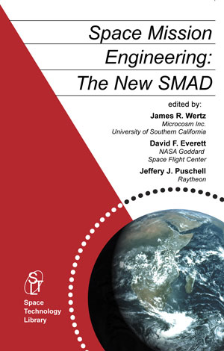
Need Robust Mission Engineering to Get Underway
“6 months in the laboratory can save you a week in the library”
Need strong mission engineering – without “optimal engineering”
We know how to do this – Microcosm literally wrote the book on it
There is an enormous body of excellent literature from O’Neill, his colleagues, and many others
Have a USC graduate student underway on sorting out what is needed and what exists
Do you or your company have anything to contribute to these or other critical first round topics?
Space economics Who owns the Moon? Manufacturing on the Moon Colony architecture Co-branding income Low gravity biology
Settling the Moon isn’t primarily a technology issue. It’s an economic, legal, social, scientific, technical, and political issue that needs a variety of skilled professionals.

Slide 14
An Example of Atypical (but potentially very large) Income Generation on the Moon
“Hello. I’m Julie Wellman and I’m a graduate student at the University of Southern California working in the brand new and exciting field of gravitational biology here near the south pole of the Moon. The terrain here is over 100 million years old and is pretty rugged, but it’s no problem for my all-electric Ford Luna. Gas would be a bit pricy here on the Moon, but my Luna uses only electricity and is pretty stingy on that. Enjoy the halftime show. I’ll check in later to show you how it works in this terrain.”
Imagine that the Superbowl Halftime Show about 5 years from now is ready to begin.

Slide 15
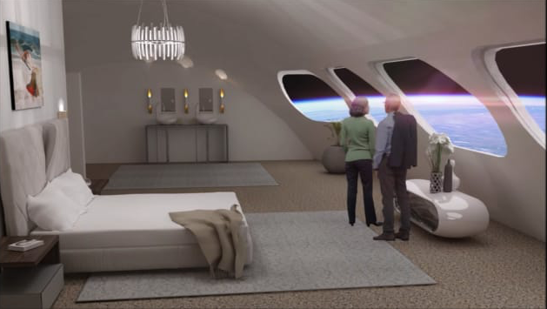
Currently Planned Hotels in Earth Orbit
Orbital Assembly Corporation currently plans for a large orbital hotel to open in 2027
Very large size: 280 guests + 112 crew
Approximately lunar gravity
Price = $5M for a 3-day stay
Location = LEO, don’t know alt.
Cost = $200B
Smaller orbital hotel planned to open in 2025
Very little details known
Key issue: Earth Orbit Hotel for tourists and scientists now in development

Slide 16
Comparison of Earth Orbit Hotels vs. Lunar Colony
Given a lunar oxygen (or lunar water) transport vehicle for round trip transport between LEO and the Moon, the transport costs are similar
Transport to the Moon may be twice the cost to LEO
Key differences
Building the colony
For orbital hotel, everything is built on Earth and transported to orbit
For lunar colony, most of the large stuff, particularly the colony itself, is built on the Moon out of materials that are on the Moon
Sources of Income
For orbital hotel: mostly tourism, limited science
Foe lunar colony: tourism, co-branding, advertising, ³He, lunar burial, education, lunar gems or material, lots of science (gravitational biology + lots more), solar system exploration, plus ~20 others
Likely to be multiple lunar colonies in multiple locations plus individual residences and meeting facilities
Key Issue: Inhabiting the Moon represents mankind expanding into the Universe with all that this implies.

